Slide 1
Compulsory English (BA-FY)- Bright Star, Would I were Steadfast as Thou Art: John Keats
Dr. Nirmala S. Padmavat
Director, IQAC
Nutan Mahavidyalaya, Selu

Slide 2
This sonnet is written by one of the most celebrated English Romantic poets, John Keats. The Romantic poets wrote in a brief time period around the beginning of the 19th century. Among the most prominent of the Romantics were three poets in particular: John Keats, Lord Byron and P. B. Shelley. These three were friends and associates who died at a very young age but they also left a very powerful on English poetry.

Slide 3
Romantic poetry is the product of emotion and expresses poet’s love towards any inspiring object in nature. It is commonly believed that the poet here is talking to Polaris, or the North Star which is famous for appearing to hold still in the sky, because of its brightness and unmoving nature. This star is used as guiding star by the travelers. In this sonnet, the poet wishes to attain the unchanging and fixed status of the bright star through his love. This sonnet was written in 1919 and was revised in 1920. It is supposed to be Keats’ last sonnet.

Slide 4
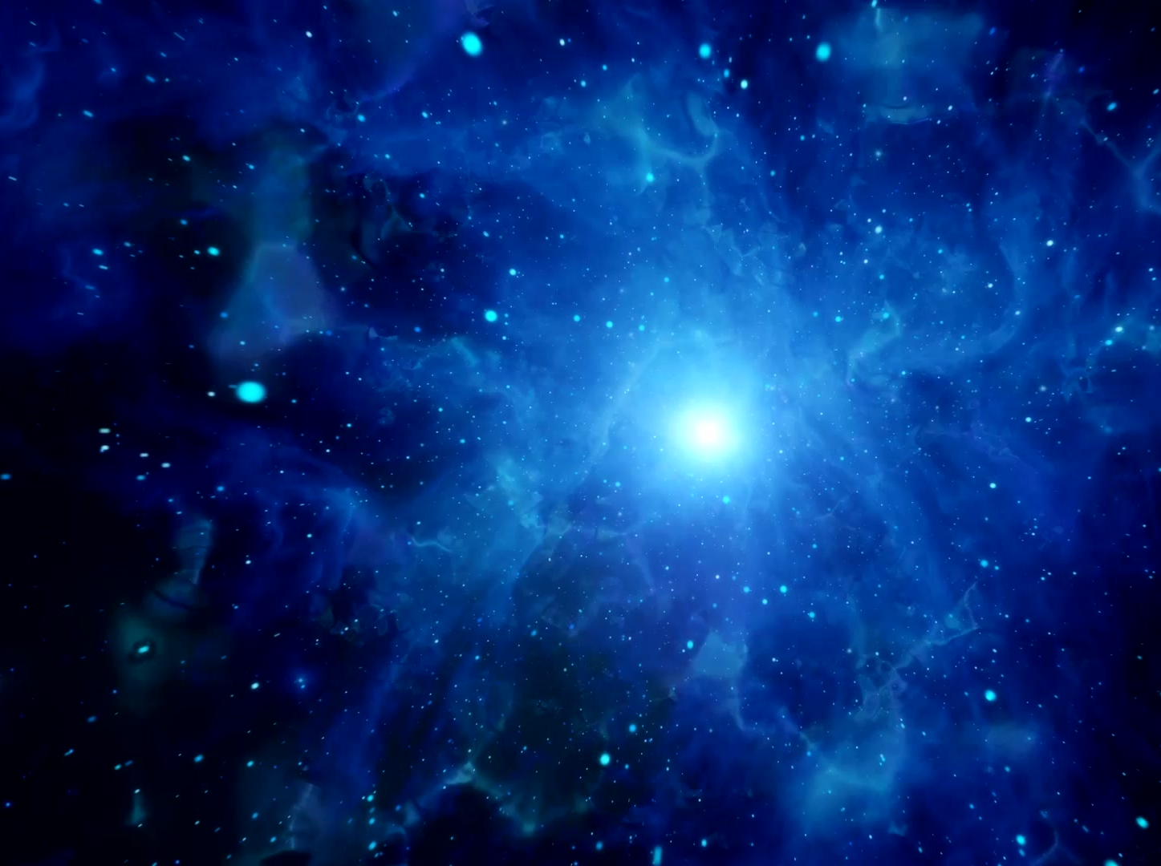
Theme of the Poem
Love, isolation and natural beauty are the major themes of this poem. The speaker observes certain qualities of the bright star and wants to adopt them. He discusses two things in the poem – the steadfastness of the star and its isolation. Thus, he wishes to be eternal with his beloved like the star but refuses to live a lonely life. He wants to stay close with his beloved.

Slide 5
It is believed that Keats wrote this poem for his beloved. The poem begins with the speaker stating that he wants to be “steadfast” like a star. He immediately goes back on this statement and gives the reader a number of reasons why he actually does not want this. The most important of these is that stars are alone. They do not have anything to occupy their minds besides the troubles of humans down below nor do they have true companions. They are alone and cold in the dark. The first two words of this piece inform the readers that the speaker is not addressing a person, but a particularly bright star.

Slide 6
This star is special because it is “steadfast.” It doesn’t move. He is envious of its patience and its eternal station. One can assume he is referring to the North Star, as it is the only one that does not move in the sky. In the beginning of this love sonnet, the speaker presents the image of the star that is referred to the title. He is addressing the star that is fixed in the sky, probably the Pole Star / North Star. This star is said to be eternal, unchanging and also beyond the speaker’s reach because it is up in the sky. The speaker wishes that he could be as steadfast as the bright star. But this star is isolated from the rest of the world. Even though the speaker admires the star and wishes to be like it, he does not want to be isolated like the star. He also does not want to have other qualities of the star, such as the star is always awake and shining.

Slide 7
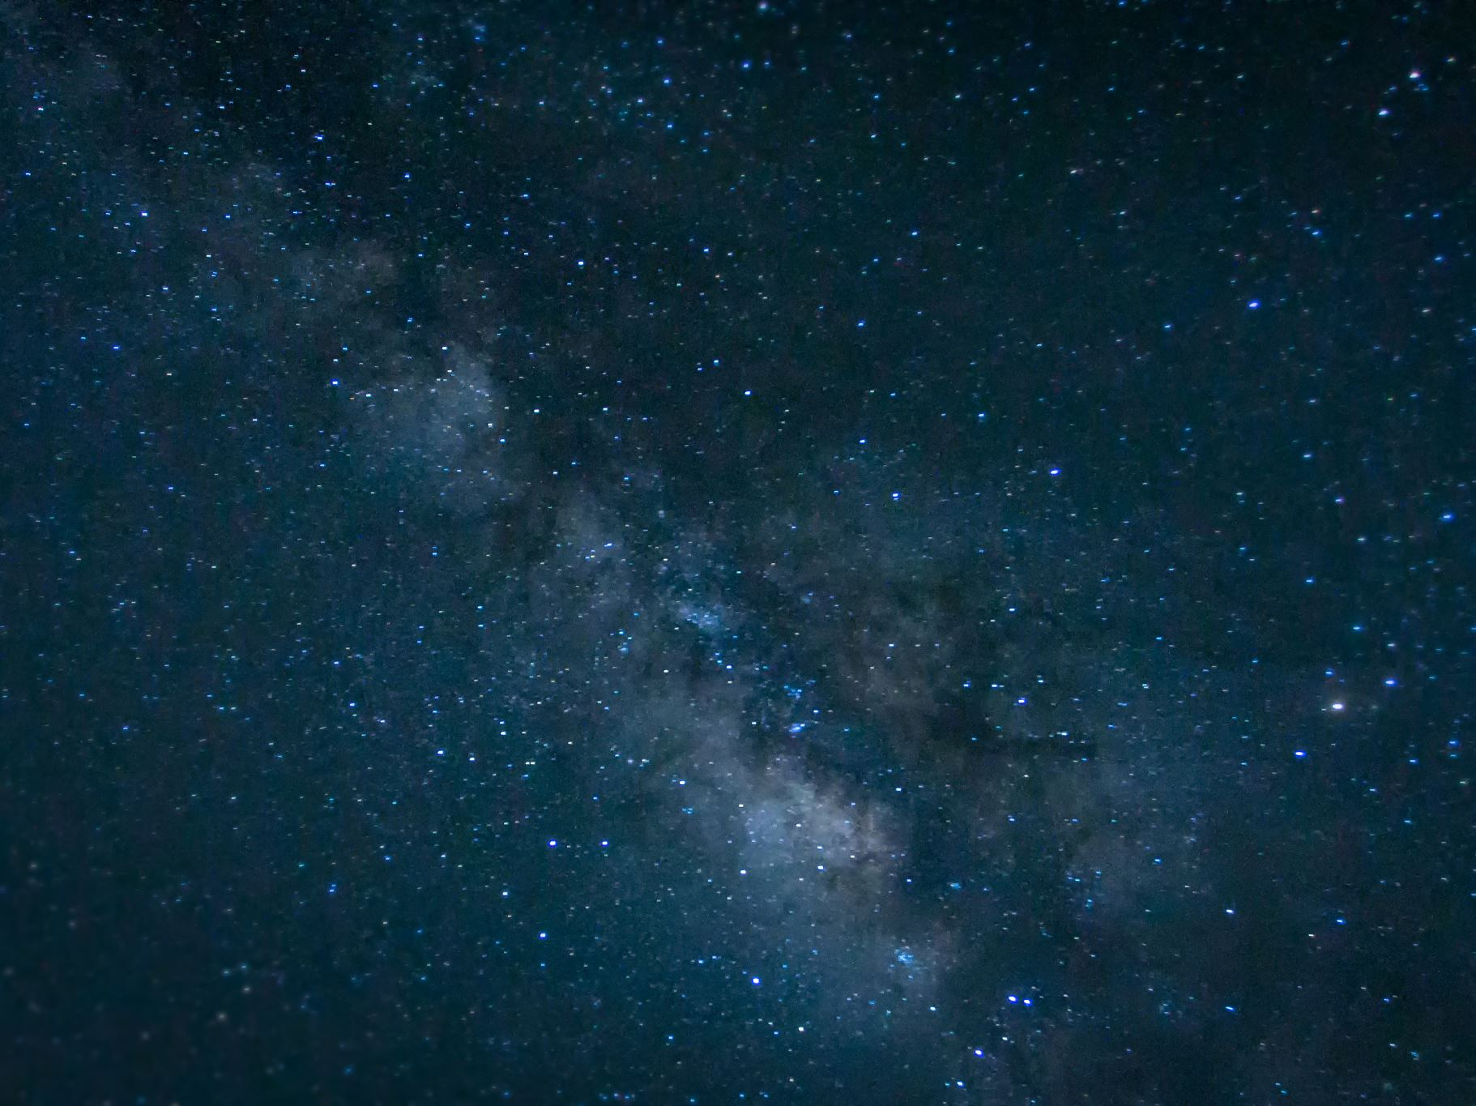
This star is special because it is “steadfast.” It doesn’t move. He is envious of its patience and its eternal station. One can assume he is referring to the North Star, as it is the only one that does not move in the sky. In the beginning of this love sonnet, the speaker presents the image of the star that is referred to the title. He is addressing the star that is fixed in the sky, probably the Pole Star / North Star. This star is said to be eternal, unchanging and also beyond the speaker’s reach because it is up in the sky. The speaker wishes that he could be as steadfast as the bright star. But this star is isolated from the rest of the world. Even though the speaker admires the star and wishes to be like it, he does not want to be isolated like the star. He also does not want to have other qualities of the star, such as the star is always awake and shining.

Slide 8
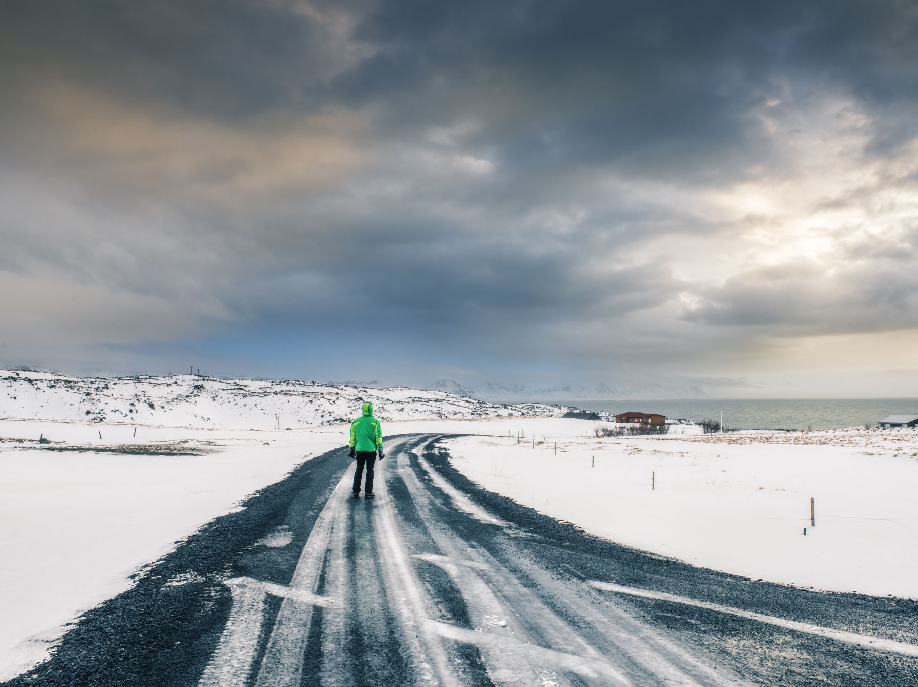
The next stanza describes the speaker’s appreciation for mountain and moors and the beautiful snow that gathers on top of its peak. Here the speaker has presented the image of a winter and lonely place. Winter has an association with solitude and sadness. Again the speaker repeats that he wants the unchangeable quality of the star but not the loneliness or solitude and sadness. Now the speaker describes himself lying on his lover’s breast and looking for relief. It becomes clear that Keats’ speaker does not have a desire to live over the world. He just wants to stay at his lover’s side for as long as he can, perhaps forever. At the end of the poem, the speaker thinks that living in comfort and happiness of love and then dying will be similar to an eternal life because when one loves, one lives eternally.

Slide 9
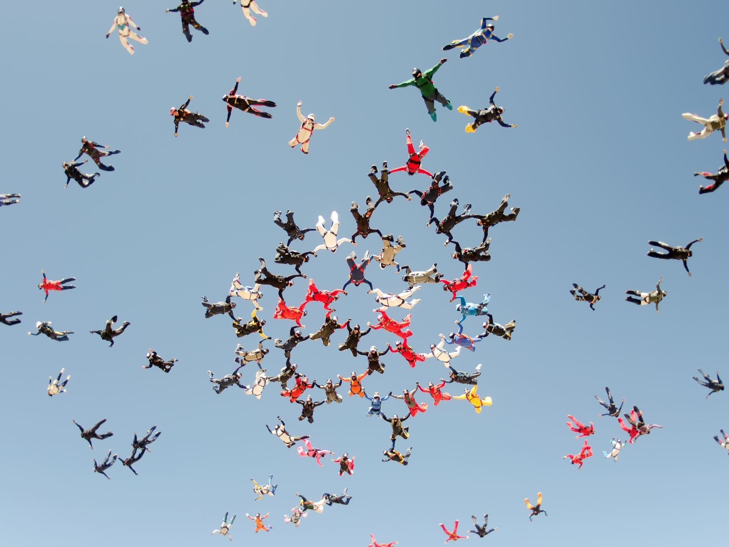
The next stanza describes the speaker’s appreciation for mountain and moors and the beautiful snow that gathers on top of its peak. Here the speaker has presented the image of a winter and lonely place. Winter has an association with solitude and sadness. Again the speaker repeats that he wants the unchangeable quality of the star but not the loneliness or solitude and sadness. Now the speaker describes himself lying on his lover’s breast and looking for relief. It becomes clear that Keats’ speaker does not have a desire to live over the world. He just wants to stay at his lover’s side for as long as he can, perhaps forever. At the end of the poem, the speaker thinks that living in comfort and happiness of love and then dying will be similar to an eternal life because when one loves, one lives eternally.

Slide 10
As this poem is about the beautiful star, the speaker directly addresses the star and wishes to remain steadfast like it. He adores its unchangeable quality and desires to attain that quality. However, he soon realizes that the star is isolated from the rest of the world and can only observe life and the beauty of nature but cannot experience it. Also, it will never taste the fruits of love. Therefore, he decides to remain steadfast and immutable in his love like that star but not in isolation. He wants to live forever with his love. He believes that death is better than having to live without his love. What stays in the minds of the readers is the metaphorical comparison he draws to show his pure love for his beloved.

Slide 11
Keats presents various themes in this poem. One of the themes is the human wish to have an eternal life. The poem gives expression to this longing; at the same time it also states that human life is essentially temporary. It cannot be eternal. The quality of eternity brings with it the aspects of loneliness, detachment and solitude. These are not the human qualities. The most valuable human quality is love. It is the essence of humanity. Keats being a Romantic poet regards love as the highest virtue. Therefore, the speaker in this poem, though attracted by the eternity of Bright Star, prefers to the rest on his lover’s side.

Slide 12
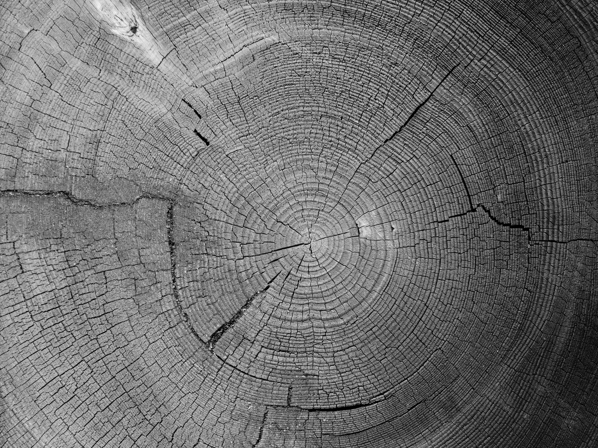
The poet also shows admiration to nature. He admires the serenity (peacefulness) of natural beauty: the sea and the snow covered peaks. The central conflict in the speaker’s mind is that he wants eternity but that would mean stopping all the change. Change is the natural aspect of life. Opposing change would mean opposing human life.

Slide 13
Poetic Devices
Poetic and literary devices are the same, but a few are used only in poetry. Here is the analysis of some of the poetic devices used in this poem.
Sonnet: A sonnet is a fourteen-line poem with a single idea float throughout the poem.
Quatrain: A quatrain is a four-lined stanza borrowed from Persian poetry. There are three quatrains in this poem.
Couplet: There are two constructive lines in a couplet, usually in the same meter and are joined by rhyme. This sonnet ends with a couplet, which generally reveals the central idea of the poem.
Rhyme Scheme: The poem follows the ABAB CDCD EFEF GG rhyme scheme.
End Rhyme: End rhyme is used to make the stanza melodious. For example, “art/apart”, “night/Eremite” and “task/mask.”

Slide 14
Literary Devices
Literary devices are tools that the writers use to shape their ideas and emotions. Their usage makes the text captivating and opens it up to multiple interpretations. Keats has also used some literary devices in this poem to explain his ideas of pure love. The analysis of some of the literary devices used in this poem has been stated below.
Assonance ( स्वरसाम्यता): Assonance is the repetition of vowel sounds in the same line such as the sound of /a/ in “Like nature’s patient, sleepless Eremite” and the sound of /e/ in “No—yet still steadfast, still unchangeable.”
Symbolism: Symbolism is the use of symbols to signify ideas and qualities by giving them symbolic meanings different from their literal meanings. In the sonnet ‘Star’ symbolizes desire.
Consonance: Consonance is the repetition of consonant sounds in the same line such as the sound of /l/ in “To feel for ever its soft fall and swell” and the sound of /n/ in “Of snow upon the mountains and the moors.”

Slide 15
Literary Devices
Simile (उपमा): It is a figure of speech in which an object or a person is compared with something else to make the meanings clear to the readers. For example, “Bright star, would I were steadfast as thou art.” Here the poem is attempting to compare himself with the star.
Personification (मानवीकरण): Personification is to give human qualities to inanimate objects. For example, ‘And watching, with eternal lids apart’ as if the star is human that can perform certain actions.
Imagery ( कल्पना): Imagery is used to make readers perceive things involving their five senses. For example, “And watching, with eternal lids apart “; ” The moving waters at their priest like task ” and ” Pillow’d upon my fair love’s ripening breast”.
Enjambment: It is defined as a thought or clause that does not come to an end at a line break; instead, it moves over the next line. For example,

Slide 16
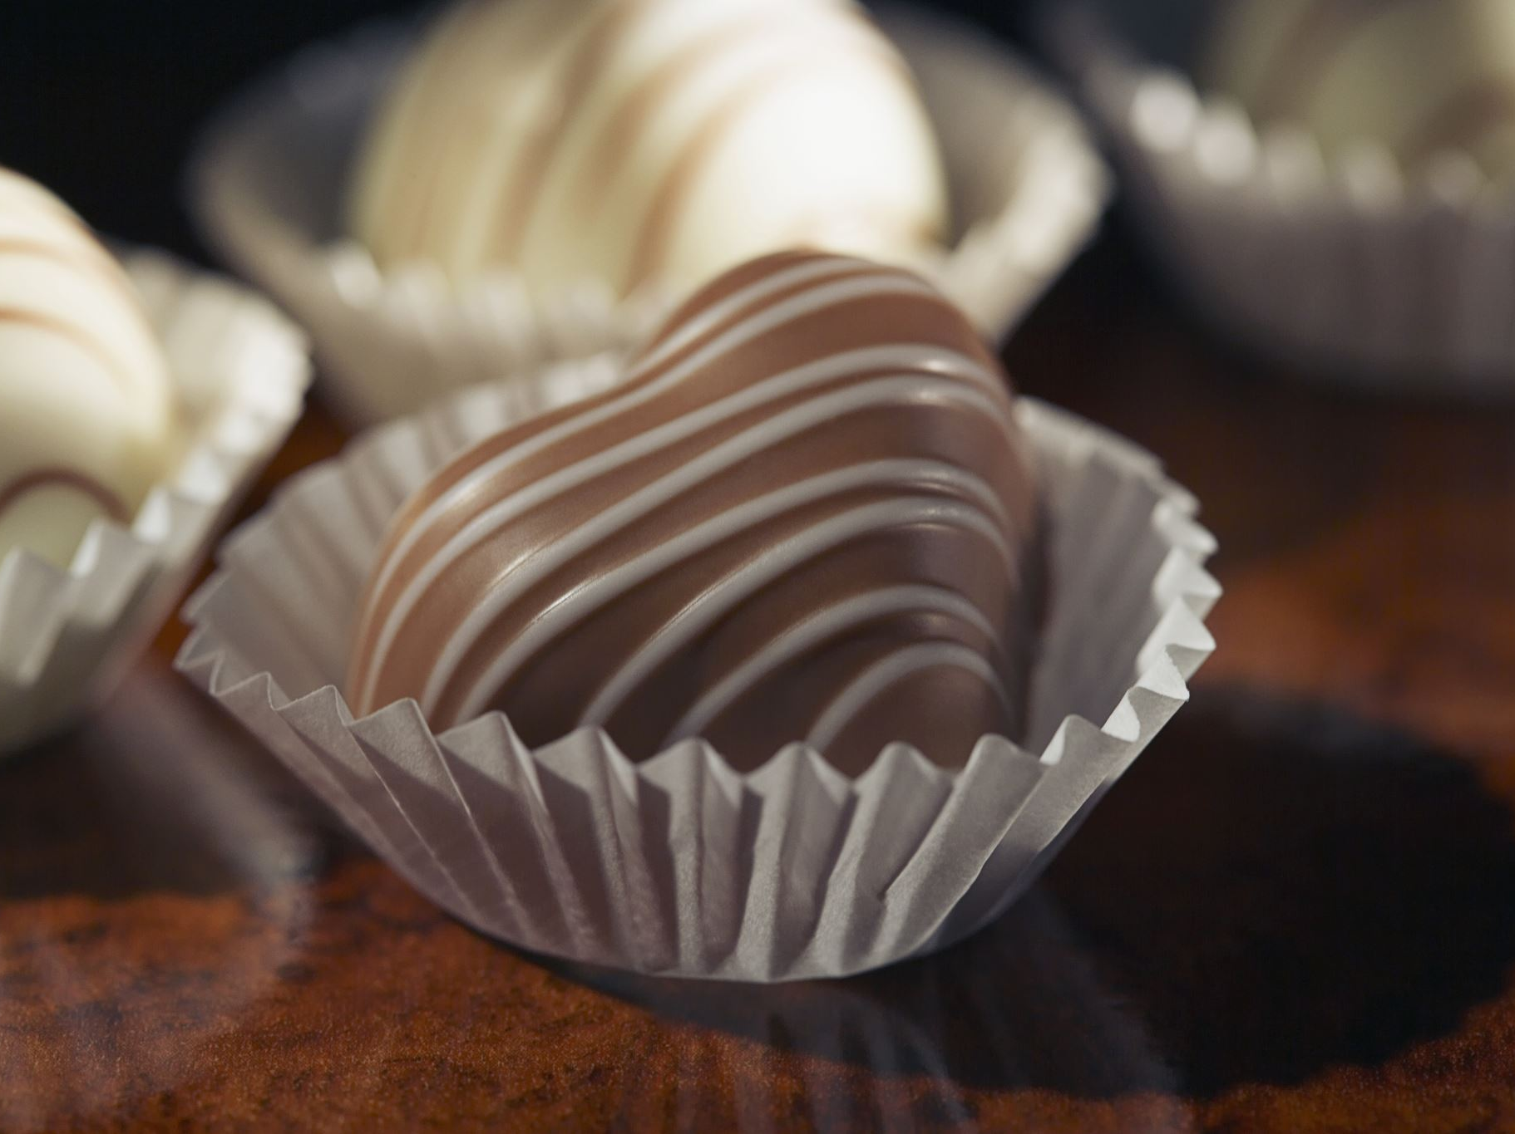
Conclusion
Hence, the speaker comes to the understanding that one can experience eternity in this life through true love. The speaker’s desire is to remain in the company of his lover forever. In the sonnet, the ‘Star’ symbolizes desire.

Slide 17
Thank you!

